Slide 1
Introduction To Renewable Energy Sources
SlideMake.com

Slide 2
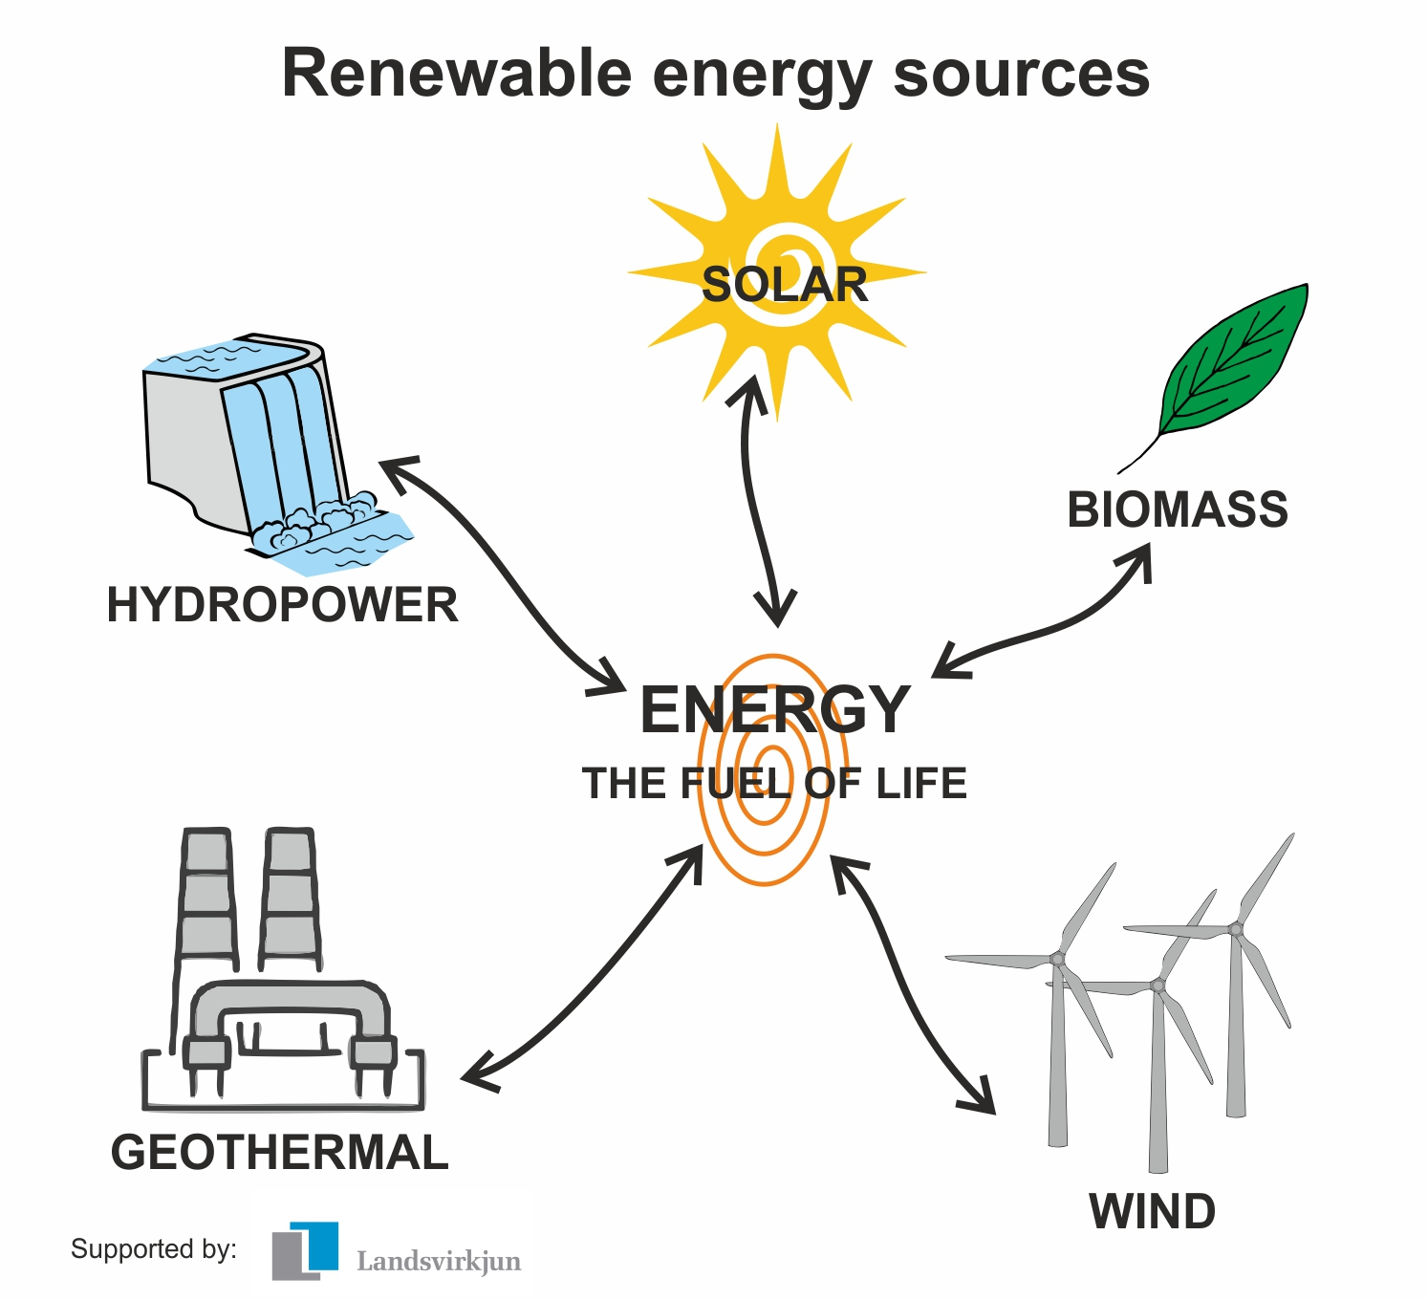
Introduction to Renewable Energy
Renewable energy is energy that is derived from natural sources that are constantly replenished, such as sunlight, wind, and water.
It is a sustainable and clean source of power that helps reduce greenhouse gas emissions and combat climate change.
Renewable energy technologies have advanced significantly in recent years, making them more efficient and cost-effective.
Notes:
Image source: https://www.vlr.eng.br/pinocho-cuento/renewable-energy-sources-and-types-ww-2378974

Slide 3
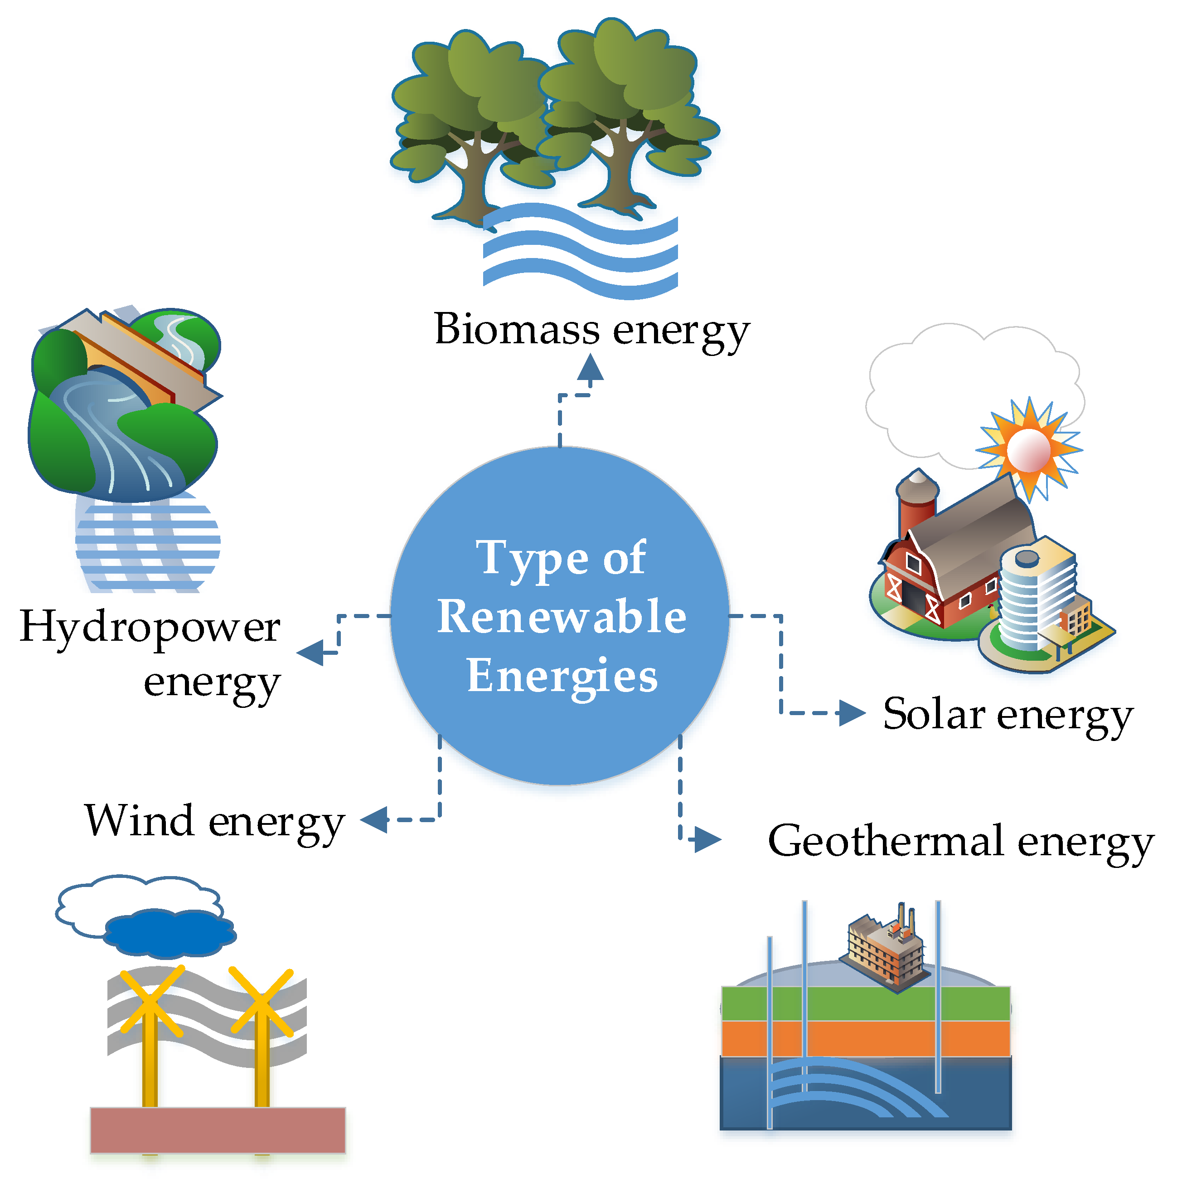
Introduction to Renewable Energy Sources
Renewable energy sources are natural resources that can be replenished in a relatively short period of time.
They are considered sustainable and environmentally friendly alternatives to fossil fuels.
Notes:
Image source: https://booksreadingaddiction.blogspot.com/2021/09/the-following-is-indirect-method-of.html

Slide 4
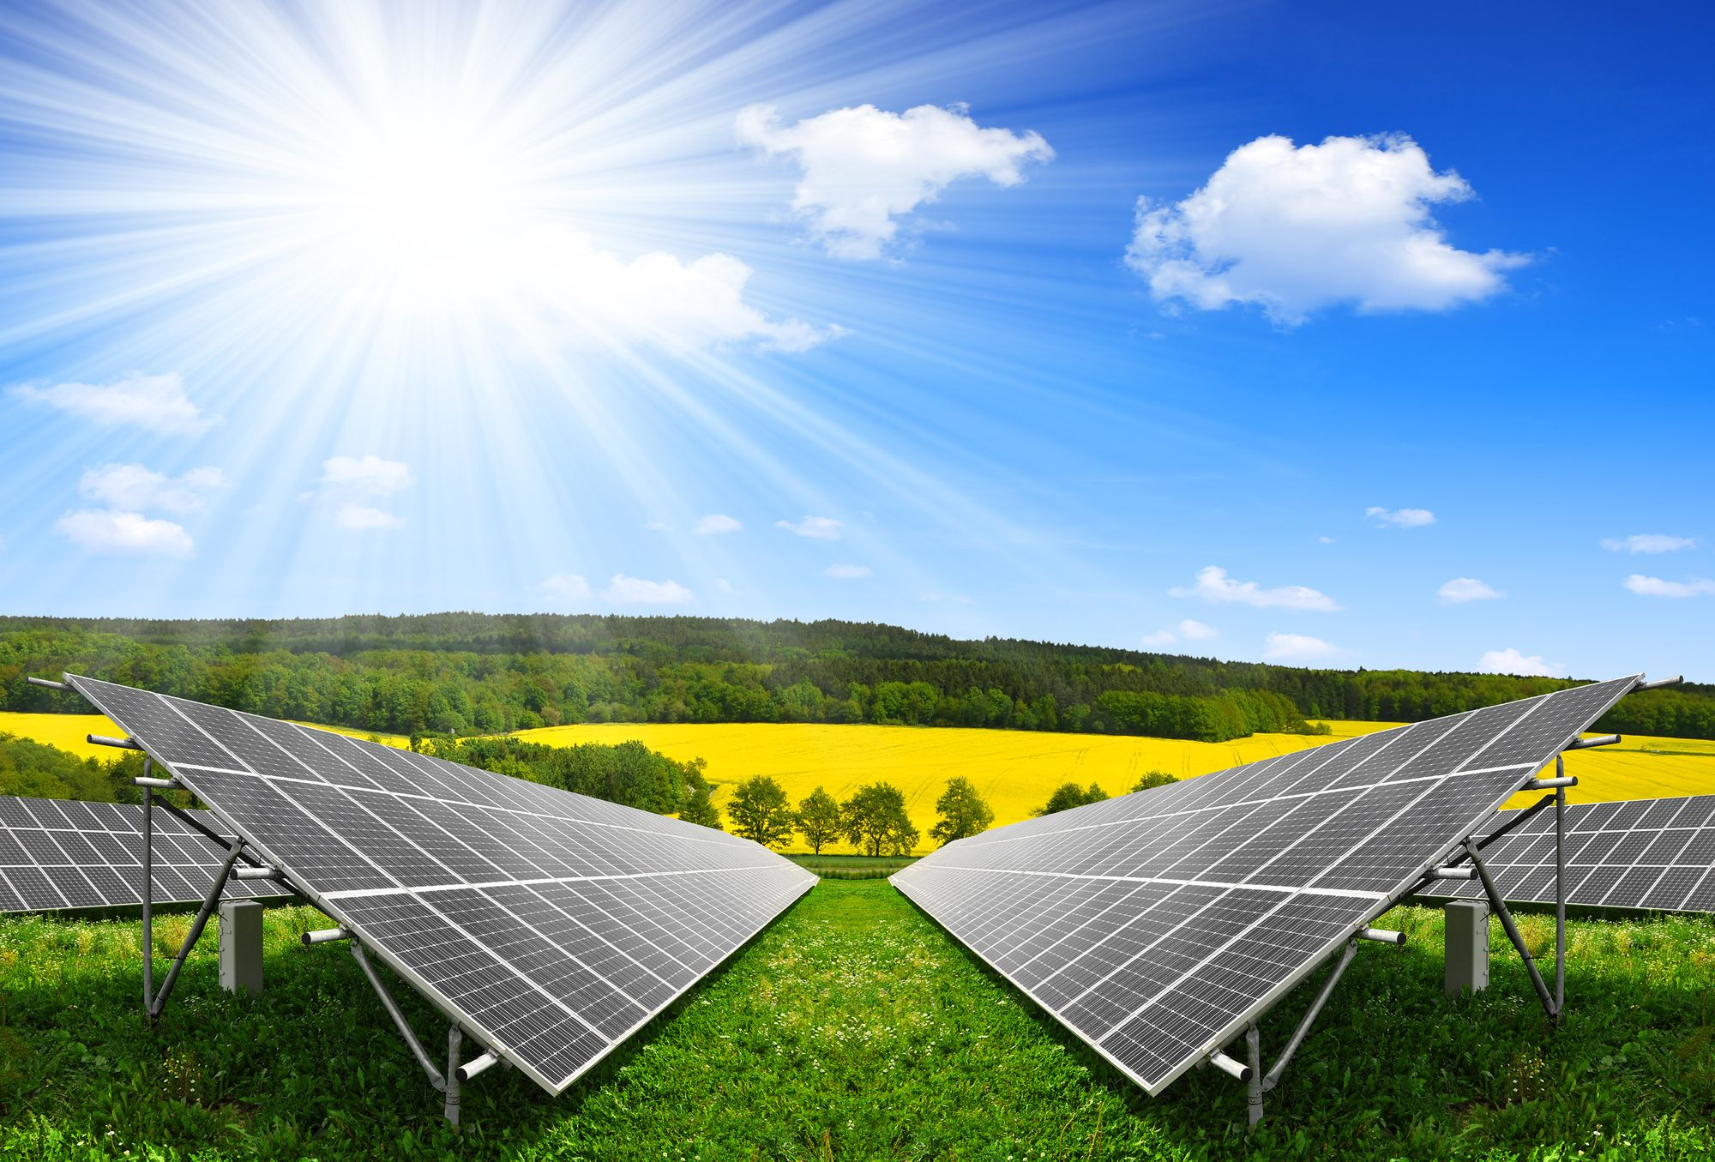
Solar Energy
Solar energy is derived from the sun's radiation and can be converted into electricity or used directly for heating and lighting.
Photovoltaic (PV) technology converts sunlight into electricity using solar panels.
Solar energy is abundant, widely available, and can be harnessed in both small-scale and large-scale applications.
Notes:
Image source: https://disterpy.blogspot.com/2021/07/effects-of-solar-energy-benefits-solar.html

Slide 5
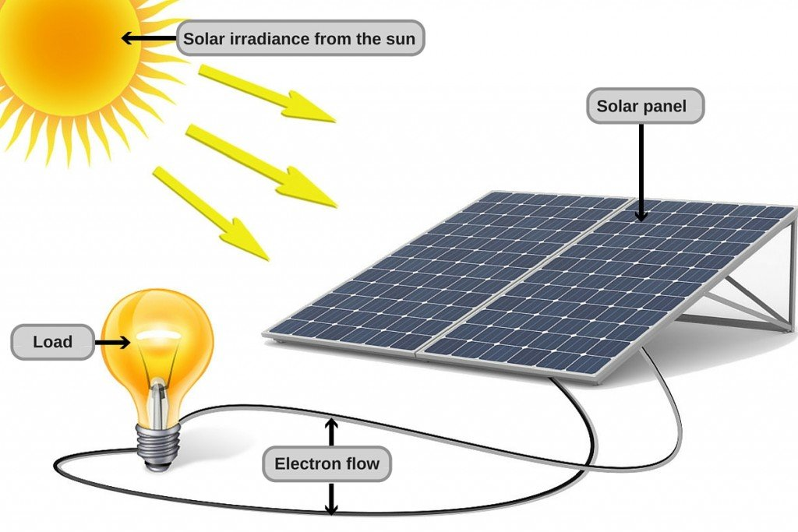
Solar Energy
Solar energy is harnessed by capturing sunlight and converting it into electricity using solar panels.
It is a versatile source of energy that can be used to power homes, businesses, and even entire communities.
Solar energy is abundant and inexhaustible, making it a reliable and sustainable source of power.
Notes:
Image source: https://matlab1.com/solar-energy-utilization-electric-generation/

Slide 6
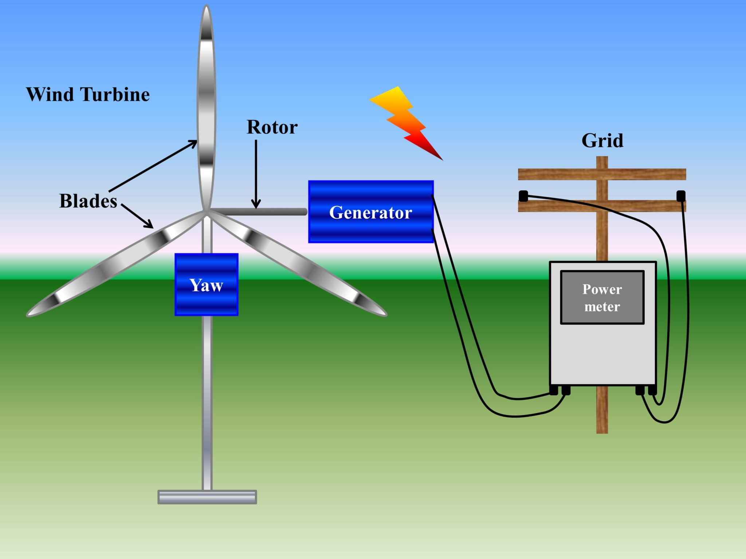
Wind Energy
Wind energy is generated by harnessing the power of wind to turn turbines and generate electricity.
It is one of the fastest-growing sources of renewable energy worldwide.
Wind energy has minimal environmental impact and can be harvested both onshore and offshore.
Notes:
Image source: https://www.asrmeta.com/wind-energy-from-wind-turbine-components-and-efficiency/

Slide 7
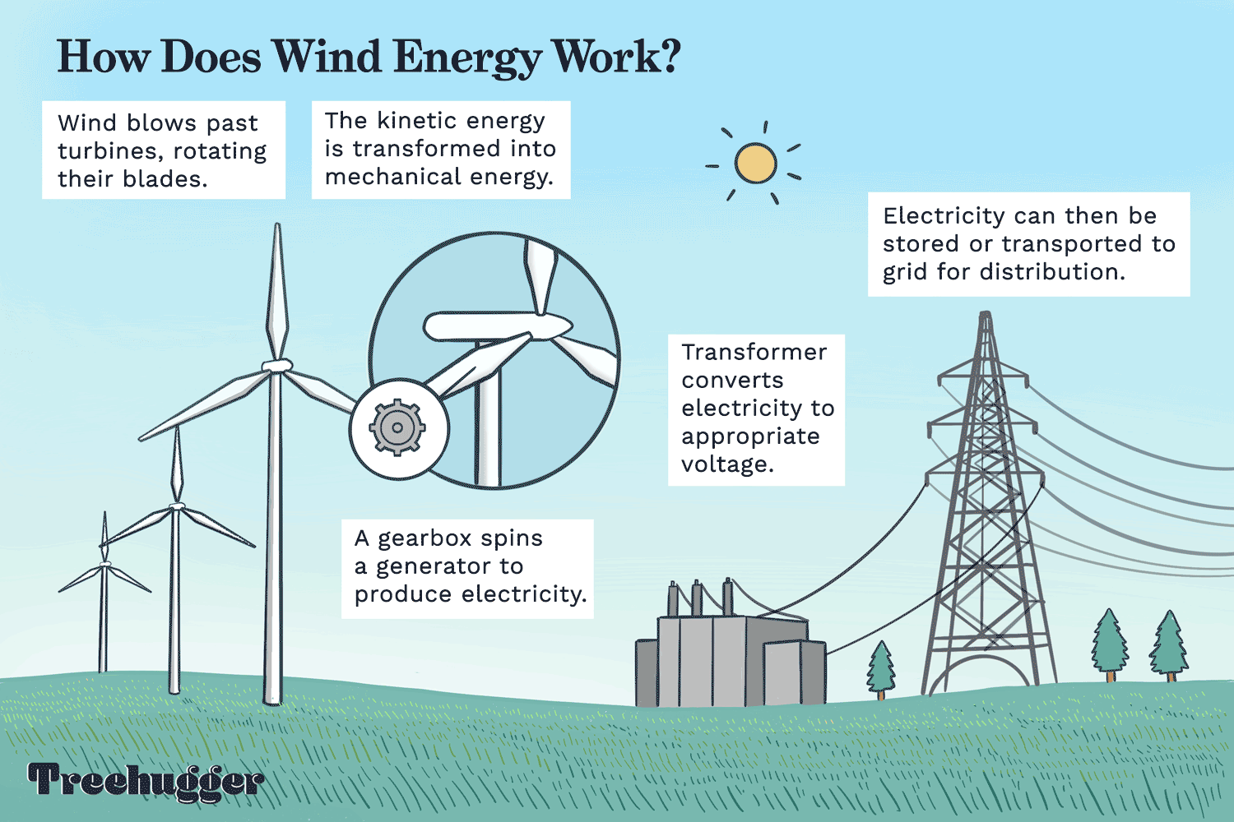
Wind Energy
Wind energy is generated by the movement of air masses due to temperature differences on the Earth's surface.
Wind turbines convert the kinetic energy of the wind into mechanical energy, which can be further converted into electricity.
Wind energy is a mature technology, with onshore and offshore wind farms becoming increasingly common worldwide.
Notes:
Image source: https://workingnotworking.com/projects/263328-wind-energy-animated-gif

Slide 8
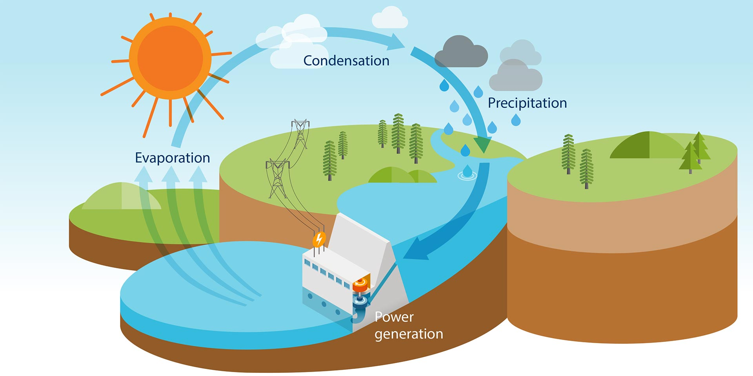
Hydropower
Hydropower is generated by using the energy from flowing or falling water to turn turbines and produce electricity.
It is the largest source of renewable energy globally, providing clean power to millions of people.
Hydropower plants can be built on rivers, dams, or tidal areas, utilizing the natural flow of water.
Notes:
Image source: http://www.hydroquebec.com/about/our-energy.html

Slide 9
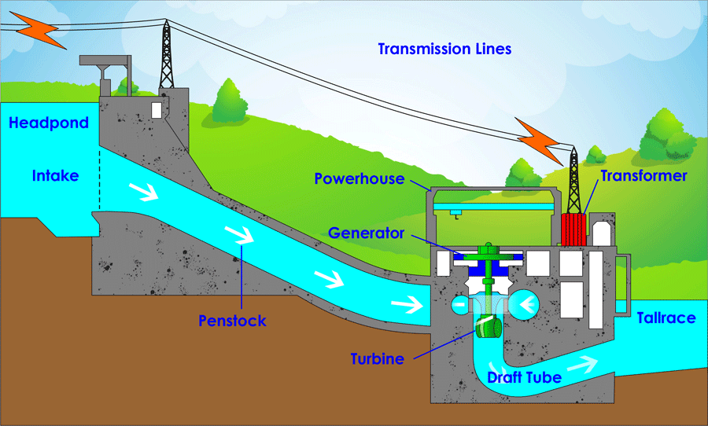
Hydropower
Hydropower is generated from the flow of water in rivers, streams, or artificial channels.
It is one of the oldest and most widely used renewable energy sources.
Hydropower plants can range from small-scale installations to large-scale dams, providing electricity and water storage.
Notes:
Image source: https://electronicslovers.com/2018/05/hydroelectric-power-site-selection-key-components-how-it-works.html

Slide 10
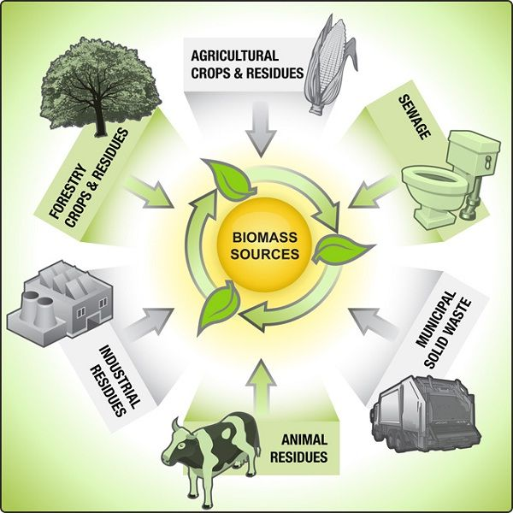
Biomass Energy
Biomass energy is derived from organic matter, such as plants, agricultural waste, and wood.
It can be converted into biofuels, used for heating and electricity production, or as a source of biogas.
Biomass energy is considered carbon-neutral since the carbon emitted during its use is offset by the carbon absorbed during plant growth.
Notes:
Image source: https://www.pinterest.com.au/pin/373446994073200677/

Slide 11
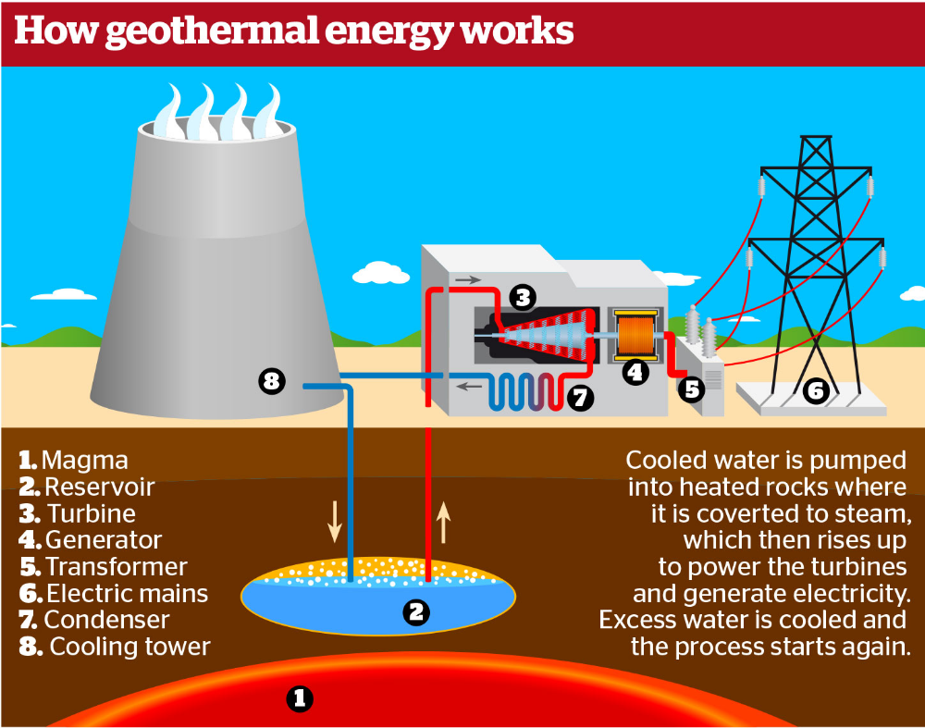
Geothermal Energy
Geothermal energy is obtained by tapping into the Earth's natural heat from within its core.
It involves using hot water or steam from underground reservoirs to generate electricity or provide heating and cooling.
Geothermal energy is a reliable and consistent source of power that is not dependent on weather conditions.
Notes:
Image source: https://definitionghw.blogspot.com/2023/08/what-is-definition-of-geothermal-energy.html

Slide 12
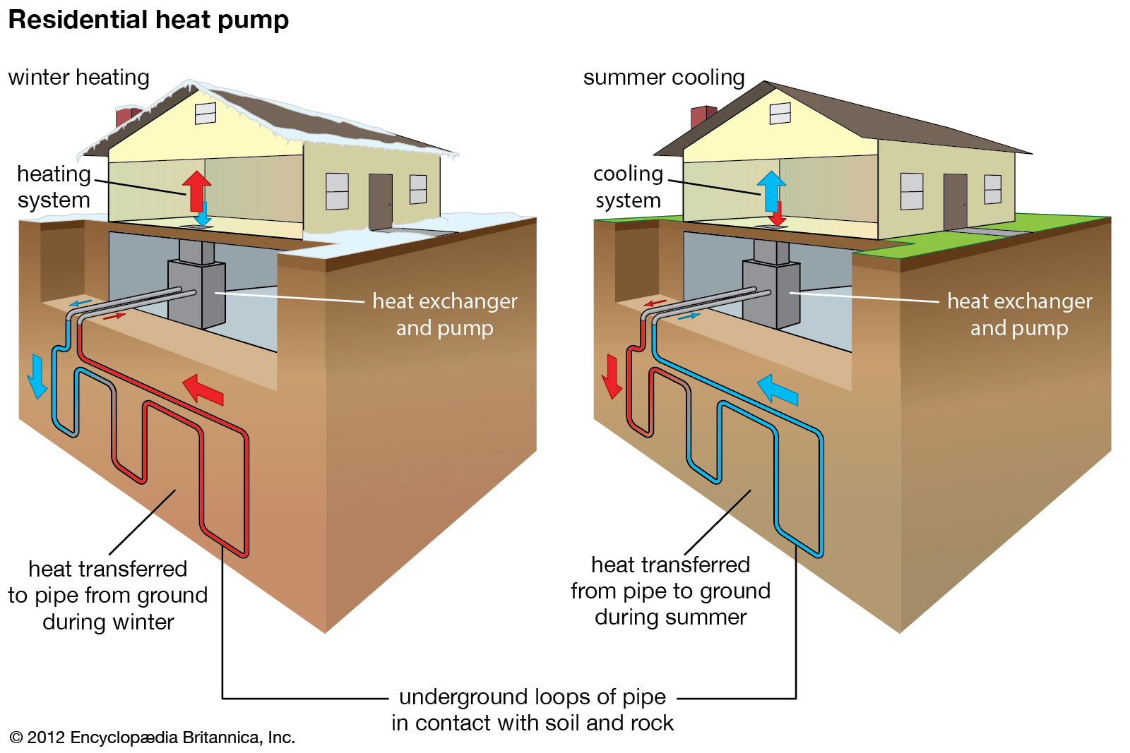
Geothermal Energy
Geothermal energy is obtained from heat stored within the Earth's crust.
It can be harnessed through geothermal power plants or geothermal heat pumps for heating and cooling.
Geothermal energy is reliable, available throughout the year, and has a low environmental impact.
Notes:
Image source: https://www.britannica.com/explore/savingearth/geothermal-energy

Slide 13
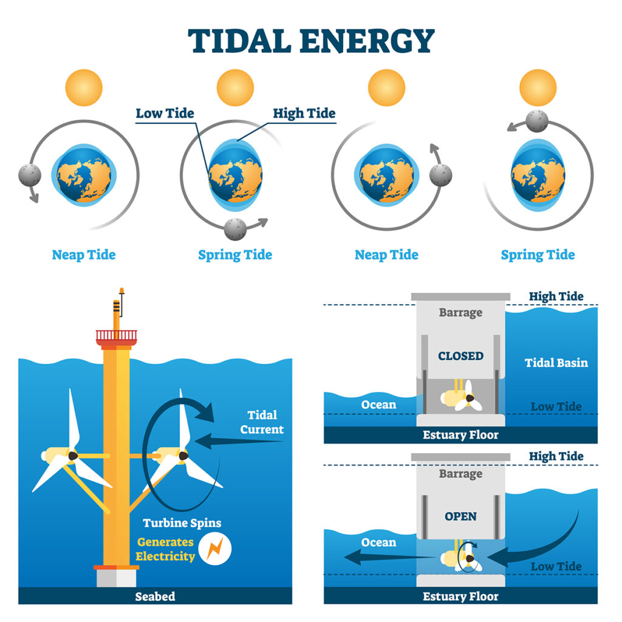
Tidal Energy
Tidal energy is generated by the gravitational pull of the moon and the sun on the Earth's oceans.
Tidal power plants use the rise and fall of tides to generate electricity.
Tidal energy has the potential to provide a predictable and consistent source of renewable energy.
Notes:
Image source: https://ecobattsolutions.com/how-does-tidal-energy-work/

Slide 14
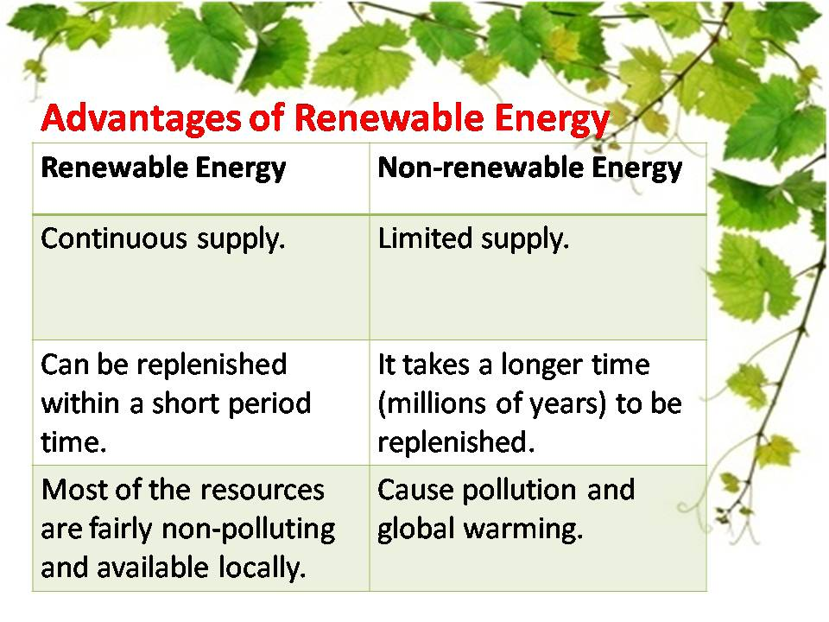
Advantages of Renewable Energy Sources
Renewable energy sources are abundant and can be harnessed in various geographical locations.
They help reduce dependence on fossil fuels, which are finite and contribute to climate change.
Renewable energy sources create jobs, stimulate economic growth, and enhance energy security.
Notes:
Image source: https://solarinstallationpanel.blogspot.com/2014/10/advantages-of-renewable-resources-of.html

Slide 15
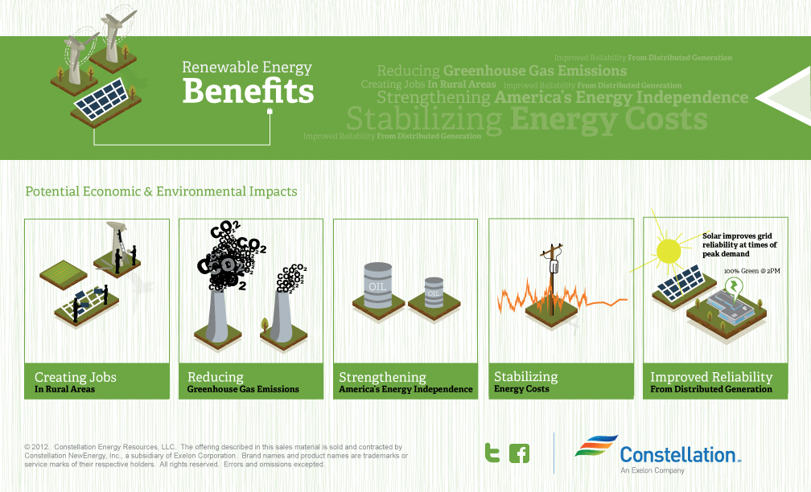
Benefits of Renewable Energy
Renewable energy helps reduce greenhouse gas emissions and combat climate change.
It improves air quality and reduces pollution, leading to better public health outcomes.
It creates jobs and economic opportunities in the clean energy sector.
Notes:
Image source: https://blog.constellation.com/2012/10/12/the-benefits-of-renewable-energy/

Slide 16
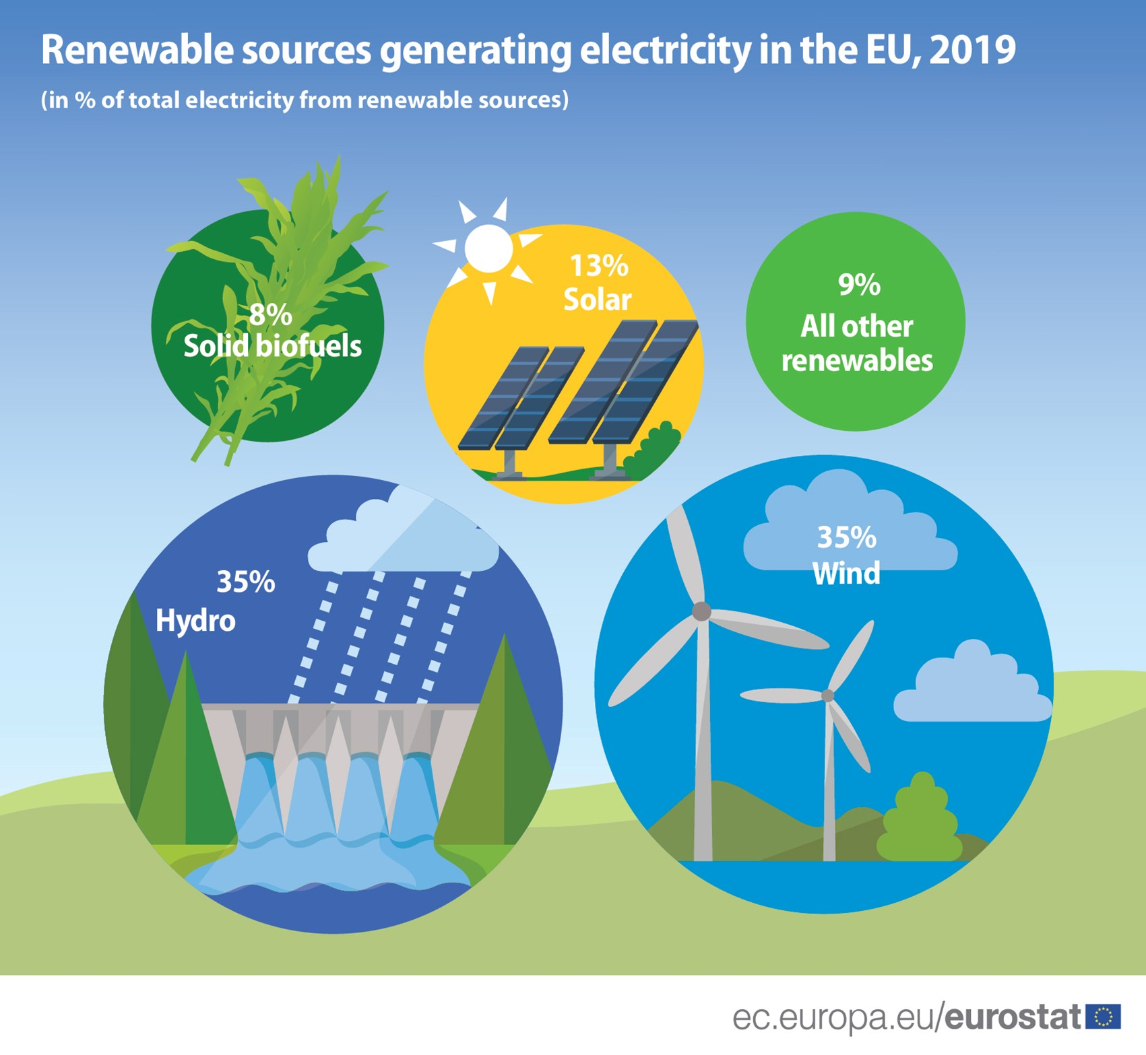
Challenges of Renewable Energy Sources
The intermittent nature of some renewable energy sources, such as solar and wind, requires energy storage and grid integration solutions.
Initial installation costs of renewable energy systems can be higher compared to conventional energy sources.
Public awareness, policy support, and technological advancements are needed to overcome barriers to widespread adoption.
Notes:
Image source: https://www.animalia-life.club/qa/pictures/energy-sources

Slide 17

Challenges and Solutions
One challenge of renewable energy is its intermittency, meaning it is not always available on demand.
However, advancements in energy storage technologies, such as batteries, are addressing this issue.
Another challenge is the initial high cost of renewable energy infrastructure, but costs are rapidly decreasing as technology improves.
Notes:
Image source: https://www.business-standard.com/article/economy-policy/tough-challenges-ahead-for-renewable-energy-sector-116050901437_1.html

Slide 18
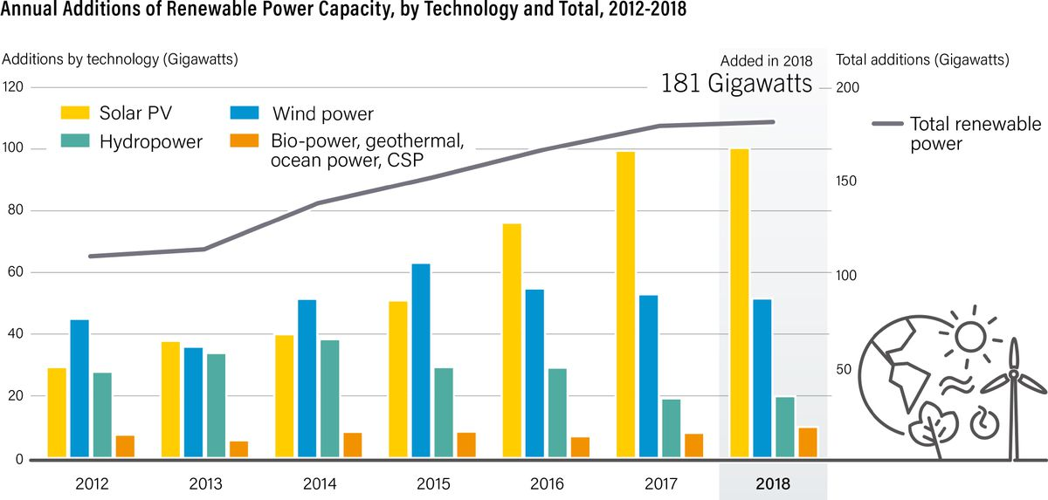
Global Progress
Many countries are actively transitioning to renewable energy to meet their energy needs and reduce reliance on fossil fuels.
The Paris Agreement, an international climate accord, has spurred global commitments to renewable energy adoption.
Investments in renewable energy are increasing, leading to significant growth and development in the sector.
Notes:
Image source: https://www.vox.com/energy-and-environment/2019/6/18/18681591/renewable-energy-china-solar-pv-jobs

Slide 19
Conclusion
Renewable energy sources are essential for transitioning to a sustainable and low-carbon future.
They offer numerous environmental, economic, and social benefits.
By investing in and promoting renewable energy sources, we can contribute to a cleaner and more resilient planet.
Notes:
Image source: https://www.weforum.org/agenda/2021/04/why-renewables-are-the-cornerstone-of-the-energy-transition/

Slide 20
References
International Renewable Energy Agency (IRENA). (2021). Renewable Energy Statistics 2021.
U.S. Energy Information Administration (EIA). (2021). Renewable Energy Explained.
United Nations Environment Programme (UNEP). (2020). Global Trends in Renewable Energy Investment 2020.

